Slide 1

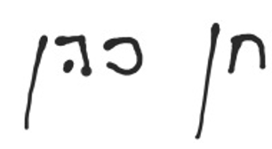
Quantum Sensing for the weather
Project Number: 24-1-1-3121.
Student names: Mohammad Shalabi.
Mentor name: Khen Cohen
Project location: The University.
Mentor signature:

Slide 2
Project Topic
Quantum-Based Opportunistic Sensing for Weather Estimation
Goal: Extend classical weather monitoring techniques, into the quantum domain for higher accuracy and robustness.
Motivation:
Classical methods: - Commercial Microwave Links (CMLs) are cost-effective but lack precision. - Classical weather sensing: measures signal strength attenuation. - Weather radar are Highly accurate but expensive.
Quantum systems: - Highly sensitive to environmental disturbances, and subtle changes. - Detects effects like turbulence & phase distortion that classical systems miss. - Potential to stabilize quantum communication channels.
Notes:
Classical weather sensing: measures signal strength attenuation
Quantum sensing: allows tracking entanglement changes directly
Entanglement may respond faster to environmental changes than power

Slide 3
Project Topic
Approach:
Use quantum communication protocols and opportunistic sensing to estimate weather conditions.
Develop models to adapt quantum signals for resilience in adverse environments.
Research Questions:
How do different noise models affect quantum signals?
Can we determine environmental conditions from quantum state degradation?
Are graph states more resilient or sensitive to noise than entangled photon pairs?

Slide 4
Updated Project Scope & Methodology
Project Adjustments:
Plan change: From simulations + experiments to simulation-first .
If results are promising and time allows, the project may expand to include experiments.
Simulation Approach:
Initial Studies & Literature Review
Simulated two entangled photons under simple noise profiles.
Found that maximally entangled photon pairs experience only minor attenuation in entanglement.
Shift to Graph States
Graph states provide a more complex and structured quantum system.
Potentially more affected; ongoing study of entanglement degradation.
Noise Modeling
Notes:
Start with a toy noise model: - Introduced Pauli noise, where a Pauli operator (X, Y, or Z) is applied with probability P. - N random Pauli operators are applied to the graph state. - Density matrix is analyzed to observe entanglement degradation.
If significant changes are observed in the density matrix and entanglement properties: - Move on to introducing physically accurate noise models. - Use log-normal and exponential noise distributions to simulate real weather conditions (rain, turbulence, dust storms).

Slide 5
Updated Project Requirements
Simulation:
Concurrence Sensitivity: Track entanglement changes due to noise, ensuring 80% consistency in trends across simulations.
Frobenius & Fidelity Metrics: Maintain at least 85% correlation between Frobenius similarity and fidelity across noise levels.
Weather Condition Classification: Develop a method to classify weather conditions from graph state changes with atlest 75% accuracy.

Slide 6
Updated Project Requirements
Experiment (if we end up doing one): - Simulation Validation: Ensure 80% similarity between experimental results and simulations. - Accuracy: Achieve at least a 5% improvement in signal accuracy compared to classical methods like CMLs. - Data Rate Requirement: Collect at least 100 measurements per second for detailed analysis

Slide 7
Project Deliverables
Characterize entanglement degradation in graph states under Pauli noise - -- Explore how entanglement degrades with increasing P (probability) and N (number of operators). -Identify significant changes in quantum properties.
Expectation Value Calculations
Focus on a single value of N at a time to analyze trends.
Determine whether noise causes statistically significant changes in similarity.
Analysis of Results & Conclusion
If Pauli noise shows clear effects, consider applying realistic noise models.
Draw conclusions on the feasibility of quantum sensing in free-space channels.
4. Simulating weather condition-based noise and study their effects.
5. Experiment setup(maybe).

Slide 8
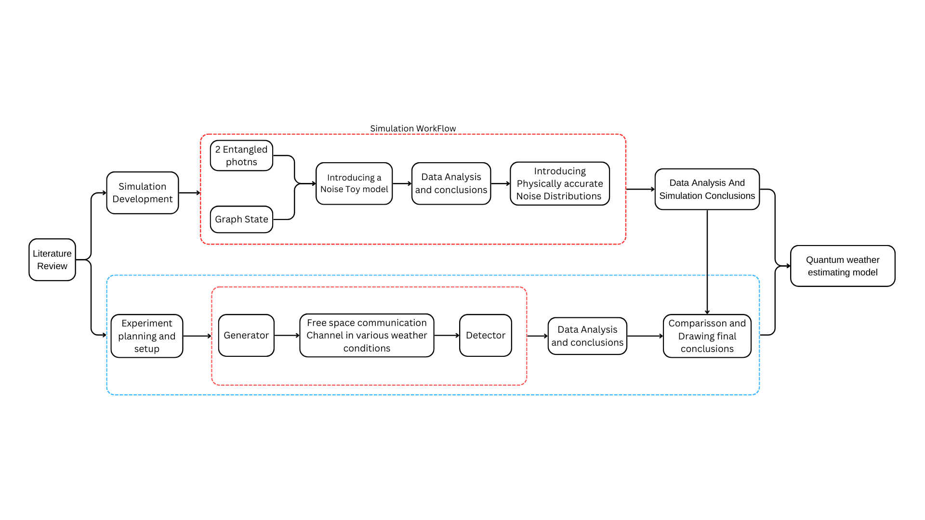
Updated Block Diagram
Using the Qiskit library in python to create the qubits and the entanglements
Applying Pauli Operators - Done
Comparison between the density matrices - Done
Introducing a PDF that simulates actual weather disturbances, also in python – Next Steps
In the blue box is the possible experiment workflow
Measure the changes in the entanglement between the qubits

Slide 9
Updated Block Diagram
Key Phases:
Literature Review: Study classical and quantum sensing methodologies, focusing on environmental effects.
Simulations: Model the impact of rain and turbulence on quantum channels.
Experimental Setup (If time and resources permit):
Construct a system and measure quantum signal behavior under different weather conditions.
Data Analysis & Model Development:
Compare classical attenuation models with quantum measurements.
Develop new models based on experimental results.
Validation: Compare simulation results with experimental data for accuracy assessment.

Slide 10
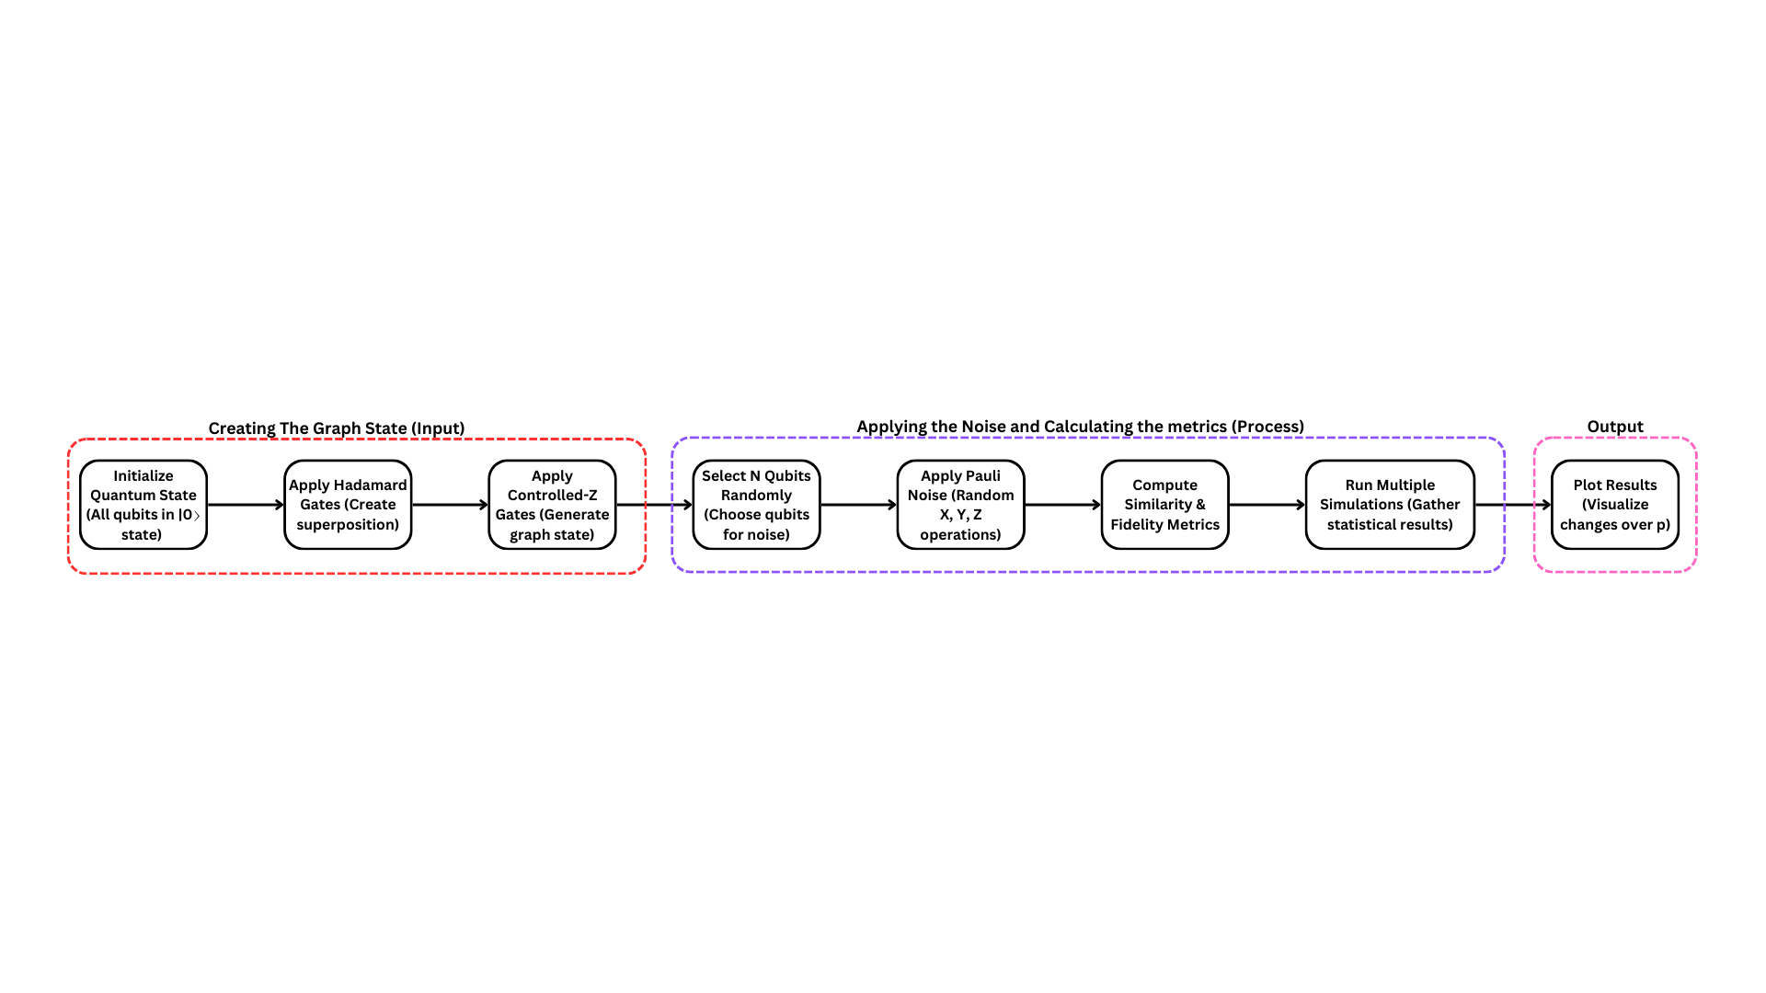
Block Diagram of the current Simulation

Slide 11
Project Products Achieved So Far
Initial Findings:
Simple entangled pairs show minimal degradation under basic noise.
Graph states display more sensitivity to noise.
Simulations Conducted:
Generated and visualized graph states.
Applied Pauli noise, analyzed fidelity and Frobenius similarity.
Next steps:
Introduce realistic noise models.
Evaluate how entanglement degradation correlates with physical conditions.

Slide 12
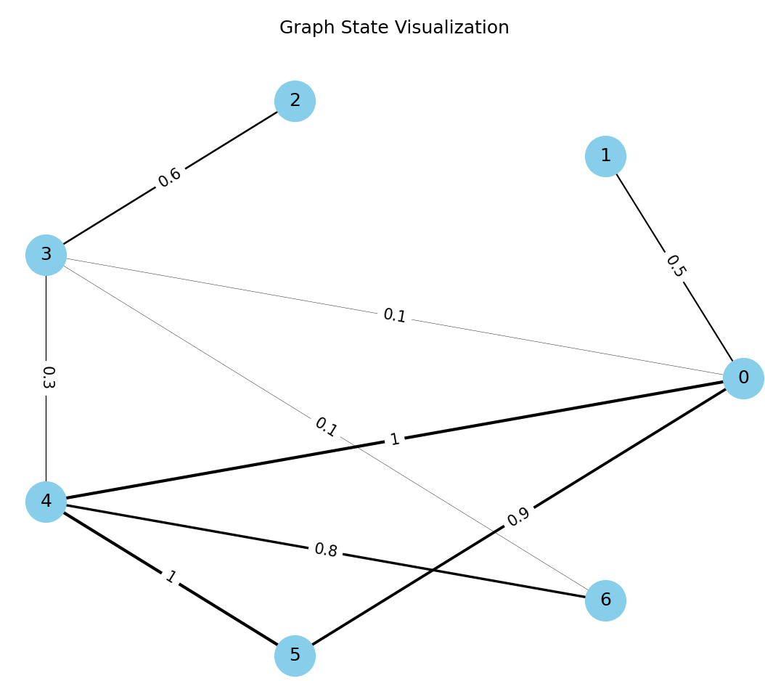
Simulating and Visualizing Graph states
Notes:
Just a Random graph state, with random entanglement values between states

Slide 13
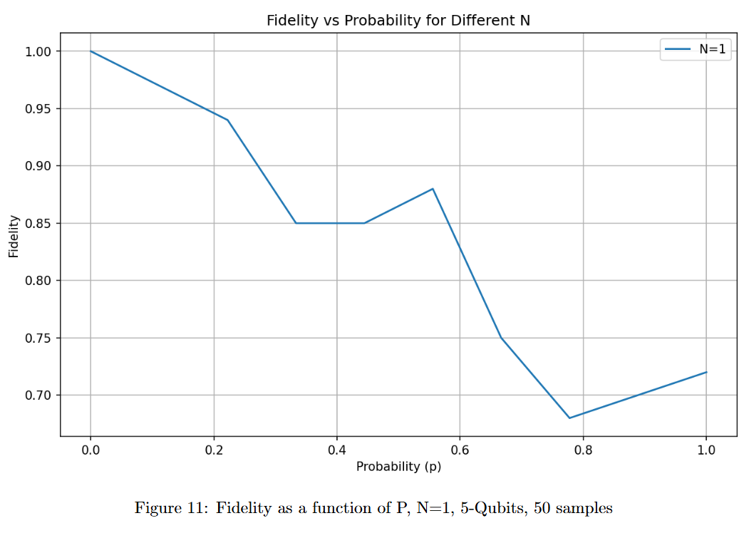
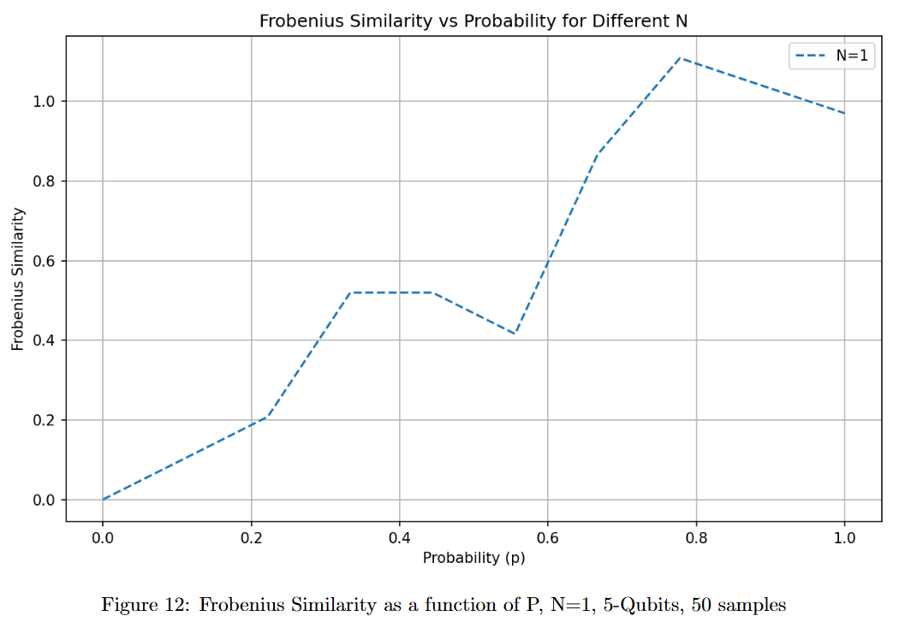
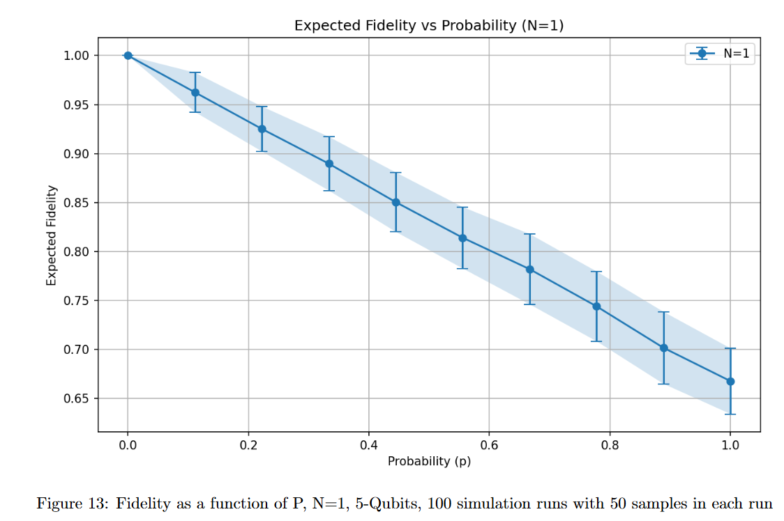
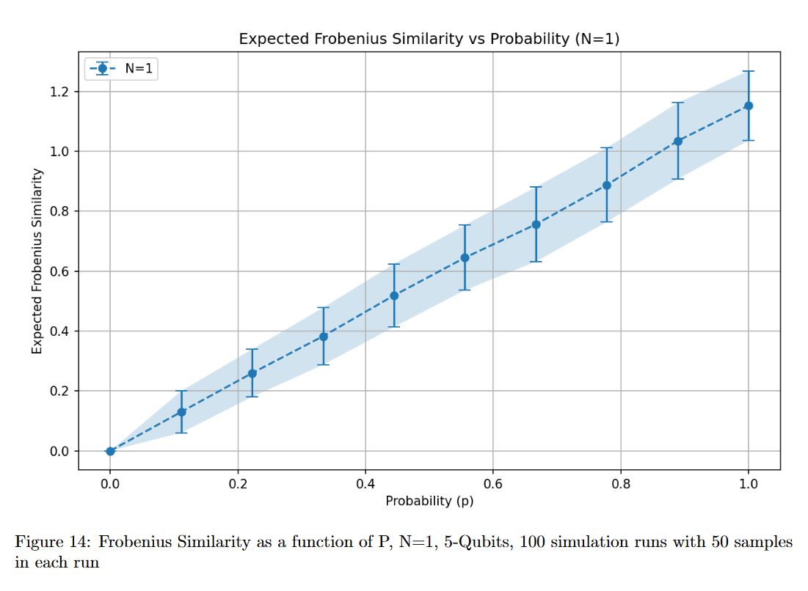
Toy Model Results

Slide 14
Simulation Results - Fidelity & Frobenius Similarity
Graph state under Pauli noise:
Fidelity decreases with increasing noise probability.
Frobenius similarity provides additional insights into state changes.
Key Observations:
Even a single Pauli operator can significantly alter the quantum state.
Important for determining whether environmental effects can be detected.
Changing the probability linearly, showed a linear change in the expected value, which might indicate that it would behave similarly with a given probability distribution, in turn we’d be able to identify the noise/ weather profile.

Slide 15
Updated Project Schedule
 | Milestone | Planned Date | Actual Delivery date | Remarks
1. | Literature Review | Mid-to-late November 2024 |  | It’s a research project, so the learning is always ongoing
2. | Experimental Design | Early December 2024 |  | Didn’t happen, got started with the simulations instead!
3. | Initial data collection | Mid to Late December 2024 |  | If time and resources permit
4. | Simulation Framework Setup | Early January 2025 | Mid December 2024 | Since the generator wasn’t available, we had to start with the simulations, also the switch to graph states, made us redo the simulation a few time, since we came up with a new idea of how to do things every other week
5. | Simulation Phase I | Mid to Late January 2025 | Late January 2024
6. | Progress Presentation Submission | 2.2.2025-9.3.2025 | Happening right now!
7. | Simulation Phase II | Mid to Late March 2025 | Mid to Late March 2025 | Introduce more physically accurate noise distributions
8. | Experiment Setup Completion | Early April 2025 |  | If time and resources permit
9. | Data Collection Begins | Mid-April 2025
11. | Data Analysis Phase I | Early to Mid-May 2025
10. | Poster Submission and finishing the work | 25.5.2025
12. | Final Data Analysis | Early to Mid-June 2025
13. | Final Deliverables Preparation | Late June 2025
14. | Final deliverables submission | July– August 2025

